Slide 1

DETECTION OF MARINE OIL SPILLS USING DIGITAL IMAGE PROCESSING
Formative Assessment 2
Cource: Fundamentals of Digital Image Processing
Presented By:
Varshita Tummuri (123B1F120)

Slide 2

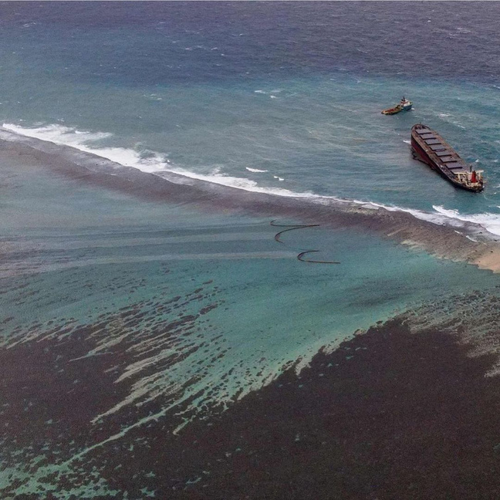
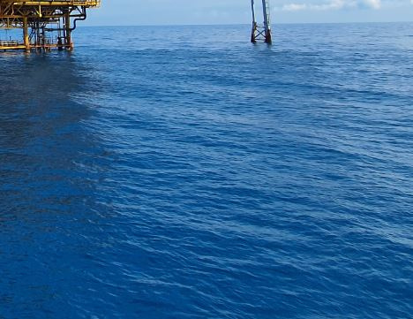
AIM
The aim of this project is to detect marine oil spills from aerial/satellite images using digital image processing techniques, by comparing the effectiveness of different image filters in enhancing detection accuracy.
oil spill
no oil spill

Slide 3
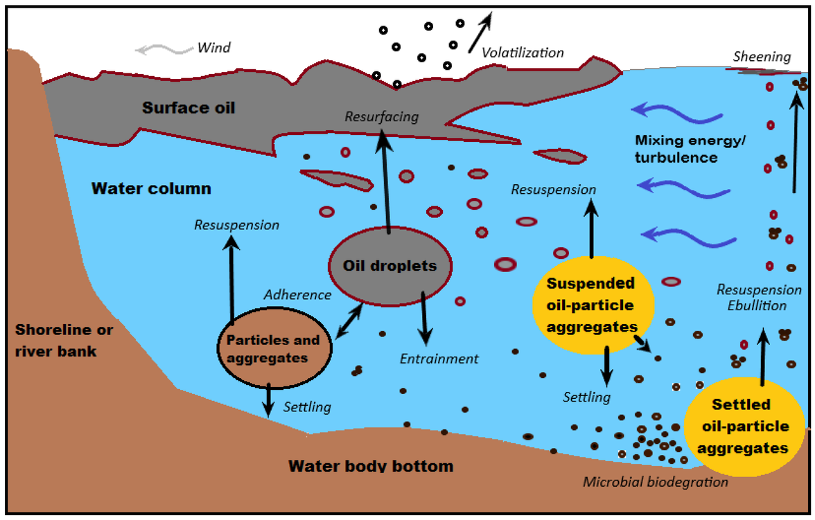
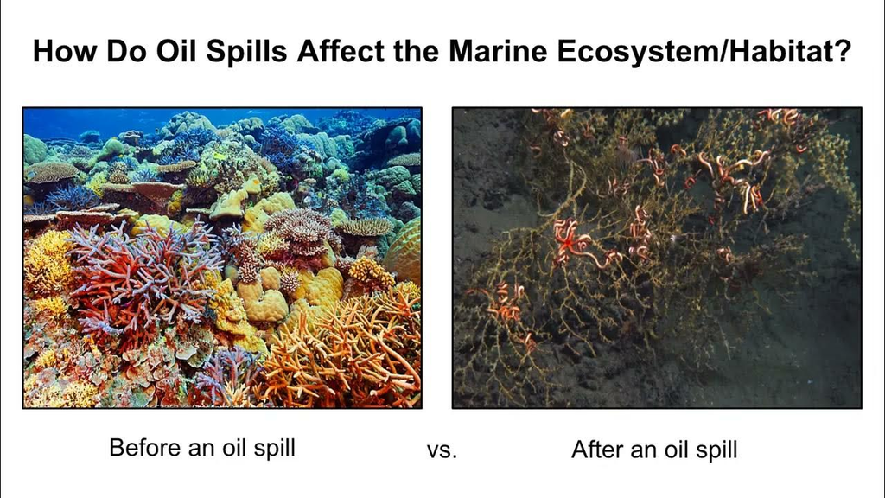
MOTIVATION
Oil spills cause severe marine pollution, affecting aquatic life and coastal ecosystems.
Early detection allows faster containment and cleanup, minimizing environmental damage.
Manual monitoring is slow and error-prone — automated systems using Digital Image Processing (DIP) can identify spills faster and more accurately.
Comparison of filters helps determine the optimal preprocessing approach for real-time oil spill detection.

Slide 4
OBJECTIVES
To preprocess satellite images using multiple filtering techniques.
To classify the regions into ‘Oil Spill’ and ‘No Oil’ using a machine learning model.
To compare and analyze the accuracy and robustness of Gaussian, Median, and Bilateral filters.

Slide 5
IMAGE PREPROCESSING
Standardization:
Resizes all images to 256×256 pixels for consistency
Grayscale Conversion:
Simplifies processing while retaining texture information
Noise Reduction:
Tests three filtering approaches:
Gaussian blur (smooths uniform noise)
Median filter (removes salt-and-pepper noise)
Bilateral filter (preserves edges while denoising)
Contrast Enhancement:
Uses CLAHE to make oil slicks more visually distinct from water
Adaptive Thresholding:
Converts to binary image, isolating potential oil regions
Edge Detection:
Canny algorithm identifies sharp boundaries (oil/water boundaries)

Slide 6
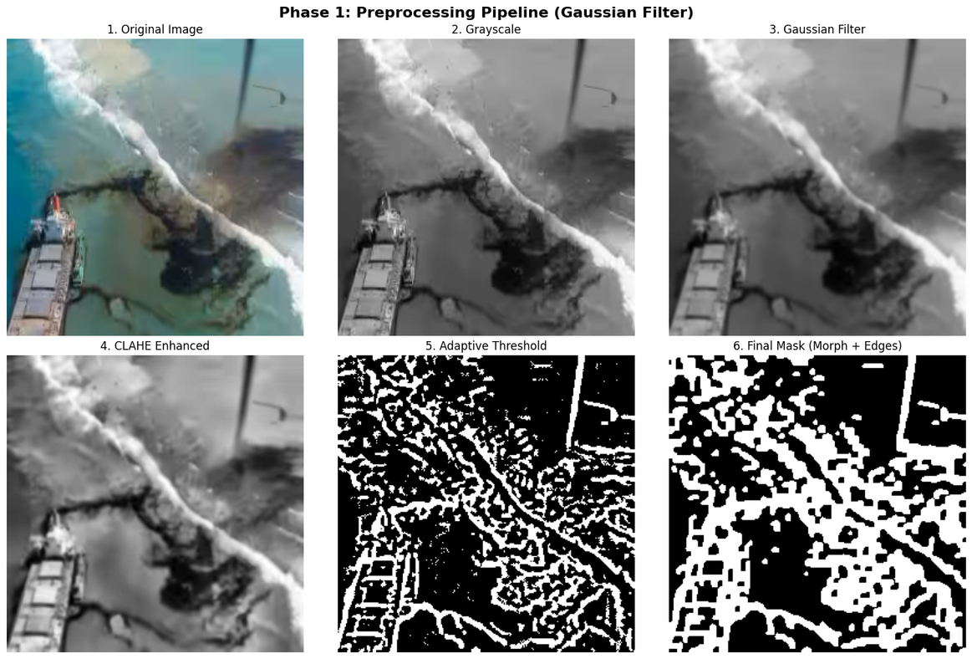
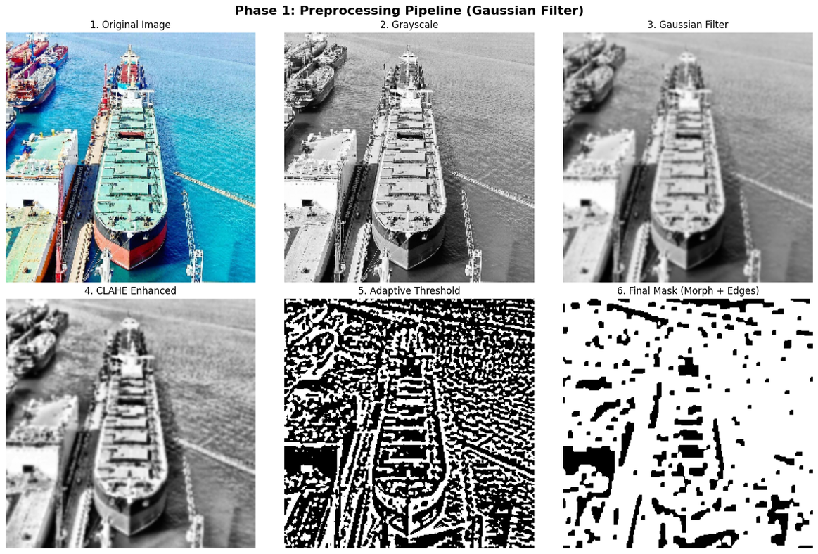
IMAGE PREPROCESSING

Slide 7
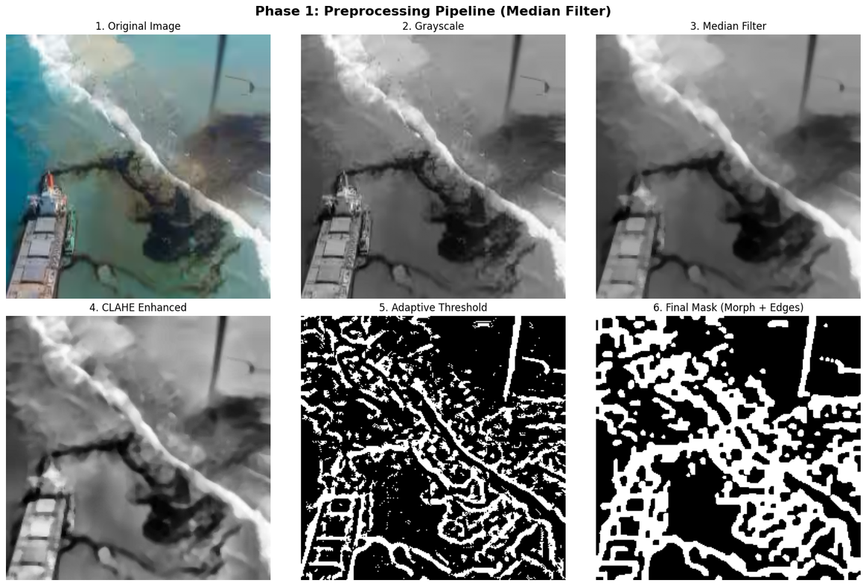
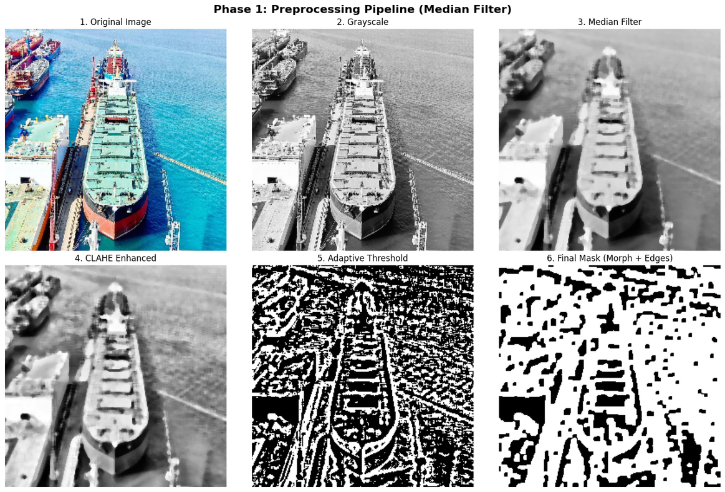
IMAGE PREPROCESSING

Slide 8
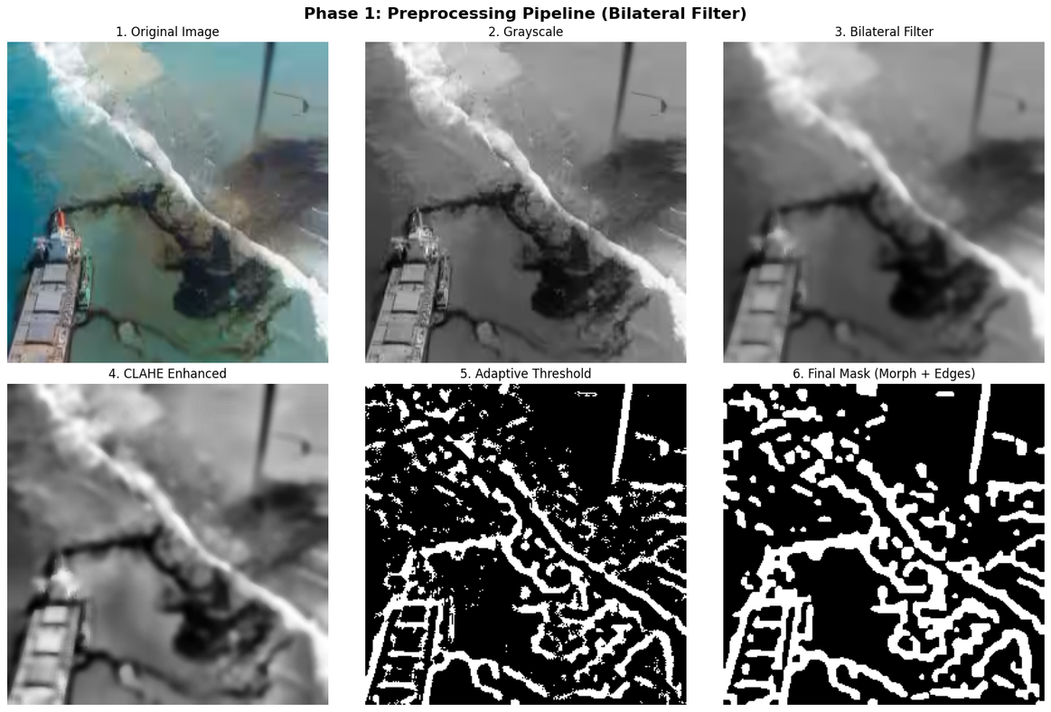
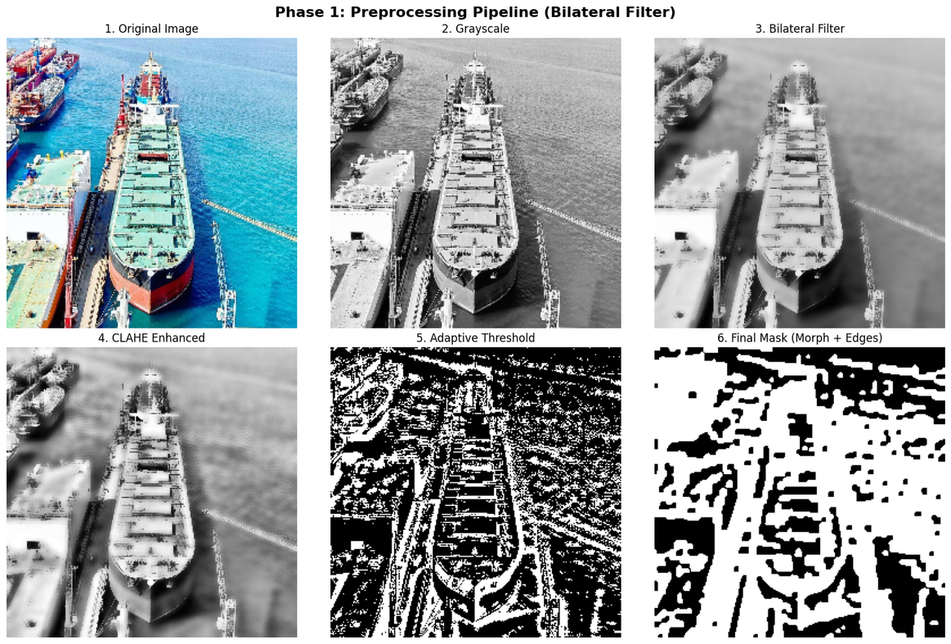
IMAGE PREPROCESSING

Slide 9
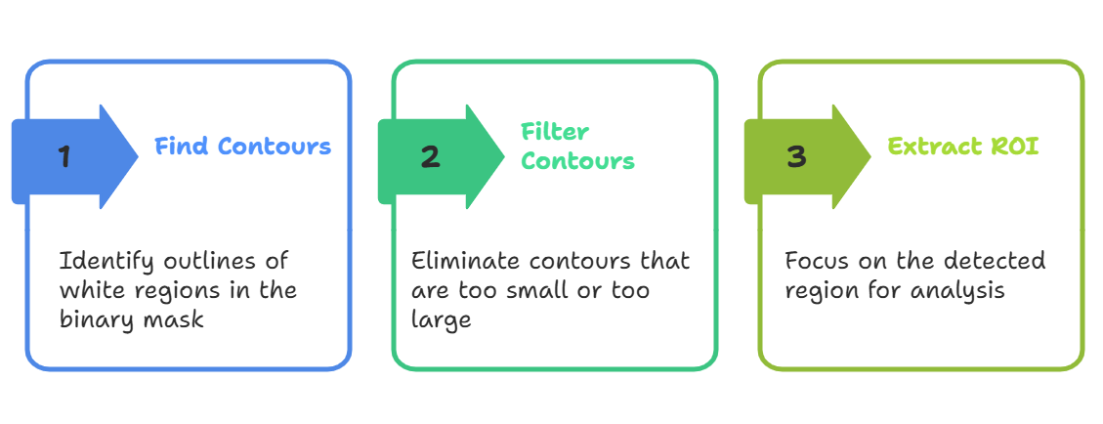
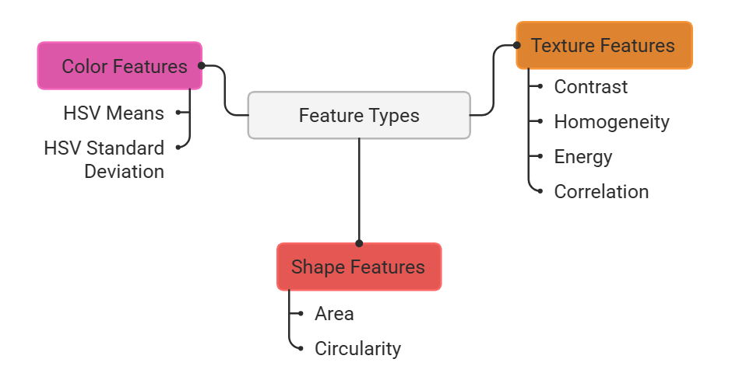
FEATURE EXTRACTION USING IMAGE FILTERS
Goal: Convert visual patterns into numerical data that an ML model can understand.

Slide 10
CLASSIFICATION
Dataset Creation: Combines features from labelled oil spill and clean water images
Train-Test Split:
80% data: Training
20% data: Testing
Stratification to maintain class balance
Model: Random Forest classifier with 150 decision trees
Ensemble method reduces overfitting
Handles non-linear relationships between features
Evaluation Metrics:
Confusion matrix (visualizes TP, TN, FP, FN)
Precision, recall, F1-score for each class
Overall accuracy score

Slide 11
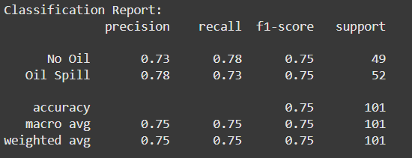
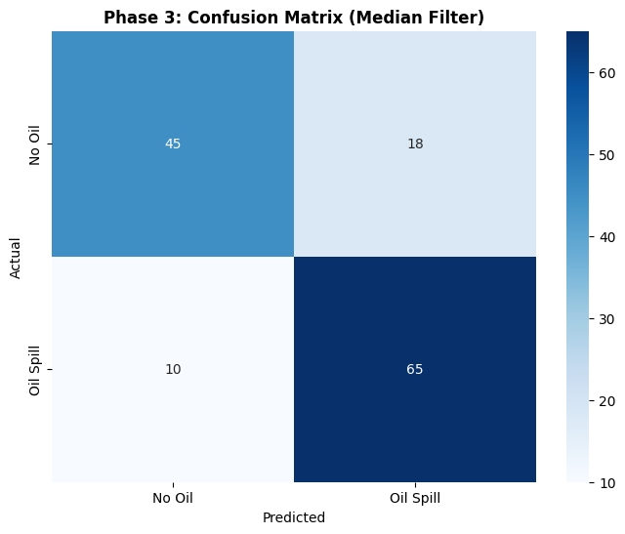
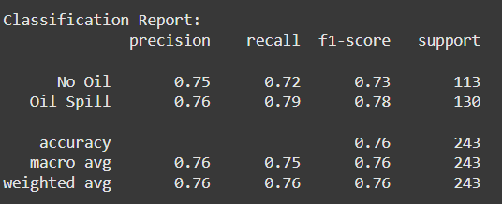
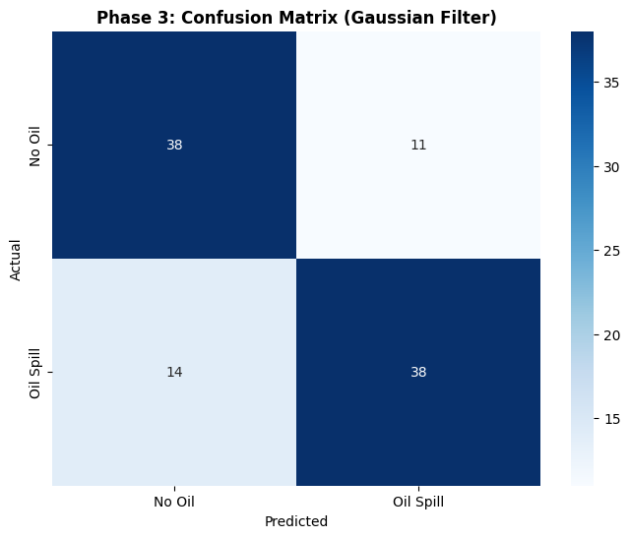
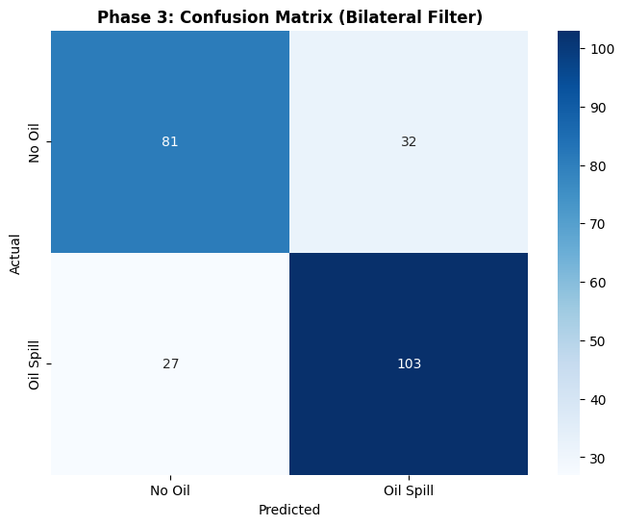
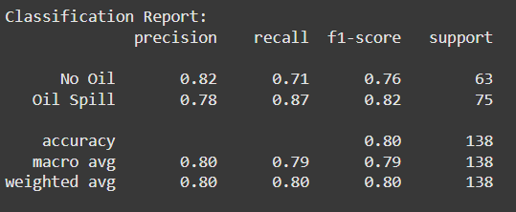
CLASSIFICATION
Gaussian Filter
Bilateral Filter
Median Filter

Slide 12
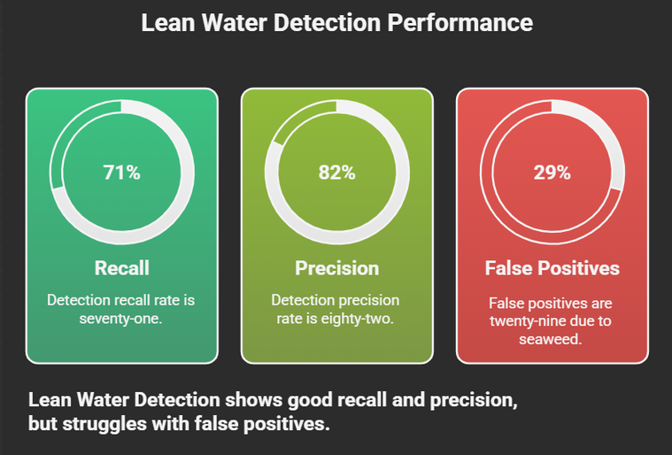
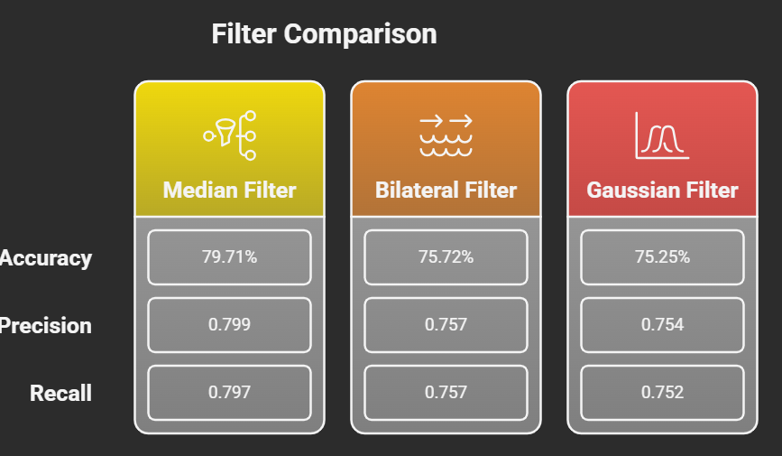
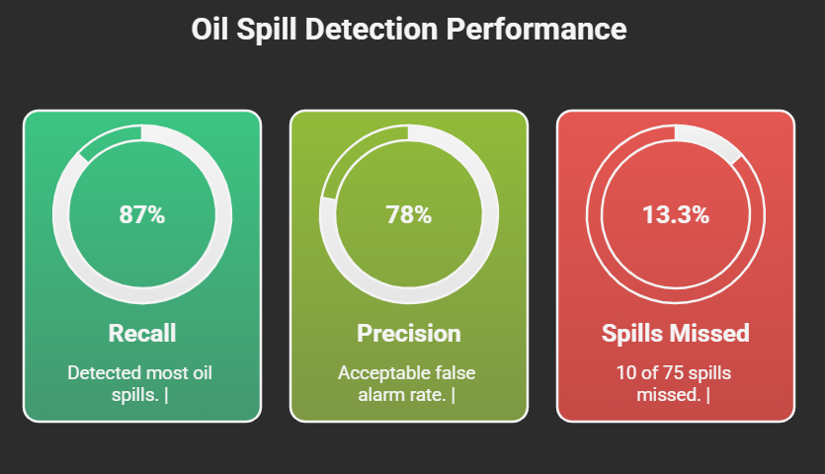
RESULTS & DISCUSSION
Key Findings:
Median filter best removes salt-and-pepper noise while preserving edges (53 contours detected)
Bilateral over-detects regions (83 contours), increasing processing without accuracy gain
Gaussian over-smooths critical texture details, resulting in smallest feature set

Slide 13
THANK YOU

